Slide 1
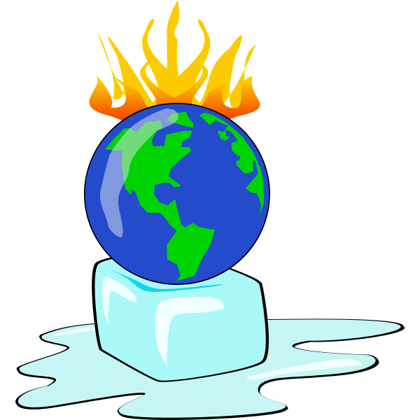
Green Goes Global
Project 2019-1-PL01-KA105-064359 – webinar prepered by

Slide 2
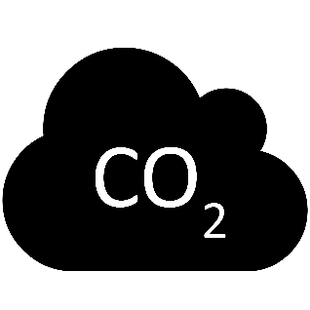
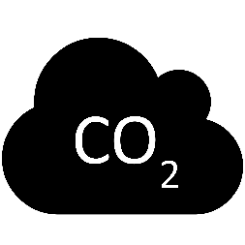
AGENDA
1. Climate change as a scientific fact.
2. Consequences of the industrial revolution.
3. The greenhouse effect.
4. Why we are using fossil fuel.
5. Climate change as a complex, environment, politic, and social issue.
6. The effects of climate change in the environment (biodiversity, oceans, food and water supplies, and weather extreme patterns)
7. Why the Paris agreement is so important?
8. It’s time to take an action!

Slide 3
What is global warming?
This is the man-made warming of our planet, where temperatures have risen by over 1 degree Celsius since the pre-industrial age.
Why is such a serious problem?
Although global warming has occurred in the history of our planet, the scientific fact is that such a rapid increase in temperature and condensation of co2 has never occurred - that kind of fast-changing environmental factors can be deathly dangerous for all living creatures on the world including humans.

Slide 4
What is the difference between:
Global Warming
Climate change

Slide 5
What is the difference between:
Global Warming
is just one aspect of climate change. “Global warming” refers to the rise in global temperatures due mainly to the increasing concentrations of greenhouse gases in the atmosphere.
Climate change
„Climate change” refers to the increasing changes in the measures of climate over a long period of time – including rising sea levels; shrinking mountain glaciers; changing weather patterns; and shifts in flower/plant blooming times .

Slide 6
Climate change as a scientific fact
The theory that we’re facing global warming and it’s caused by human activity is a scientific fact. Around 97% of scientists who are working on the topic of climate agree that we have enough evidence to claim that is true. Of course, there is a tiny possibility that we have some wrong assumptions, but for now, there is no proven alternative theory. We need to remember what history had taught us about theories. There was a time when all scientists of those days claimed that the Sun turns around the Earth, and then there was Copernicus who began to doubt. And from that very moment, the scientific revolution began.

Slide 7
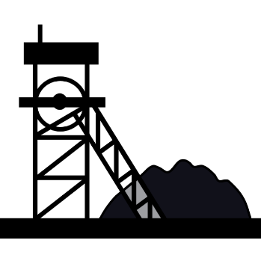
The era of industrialization
It started in the UK and spread really fast in the western world. We start to burn fossil fuels to produce energy which can be used in machines and engines. What are fossil fuels?
Those are coal, natural gas, and oil and during the process of burning it releases CO2 among others.
People started to build a comfortable future: cars, factories, electricity or central heating - every of those achievements requires a lot of energy.
And for almost 200 years burning fossil fuels was the cheapest and the most available source of energy. People back then also didn’t know about the possible consequences.

Slide 8
Consequences of the industrial revolution
Although climate science appeared naturally at the beginning of XIX (as a lot of other scientific fields), only in the 1950s scientists proved that increasing CO2 condensation in the atmosphere is related to burning fossil fuels by humans. It was also a decade with killing smog in London and the USA, and people knew already that the cause is coal burning. It was a turning point in history: designers and engineers start to think about reducing the CO2 emissions during the process of producing further machines.
Check out that currently the concentration of carbon dioxide in our atmosphere is almost 40% higher than 150 years ago!

Slide 9
What is a greenhouse effect?
What exactly scientists discovered? They take a look into our atmosphere - a thin layer of gases around our planet. It’s crucial for life in the earth because it consists of the oxygen that we breathing and also it works as a blanket - protect us from cold of the space. The atmosphere preventing a lot of heat from the Sun from escaping, one of the most important gas which this “blanket” is made of is CO2. That’s why we call CO2 a greenhouse gas, and the „blanket” we call greenhouse effect.
The problem began when the amount of this gas is rising, then the layer getting thicker and prevent more heat from escaping so the temperature on the Earth is also rising.

Slide 10
Why we are using fossil fuel?
It’s avaliable in many places
It’s cheap
It’s efficient
We used to it
You can use it in future
It’s easy to move

Slide 11
Climate change problem
Climate change is a complex, environment, politic, and social issue.
Developed countries now are able to invest their money in renewable energy which comes from wind or sun. But guess how many people lives in developed countries?
Not even 20% of all population, what about the rest of the people? More than 6 billion people still aspiring to have such a comfortable life like Americans or Germans. Lots of people still don’t have access to water, electricity or basic technology. How they can get out of poverty and other issues without providing cheap energy?
And let’s talk about one more huge factor: the population is growing very fast. At the beginning of the XXth century, there were around 1,5 billion people, now it’s 5 times more

Slide 12
Infinite economy growht
For about 70 years we already know about that burning fossil fuels release CO2 to the atmosphere and condensation this gas causes the rising of temperature. But even dough the emissions of CO2 are still growing!
Why is it like this? The mainstream economy is based on the model of economic growth which means that we producing and buying more and more. This kind of economic activity threats the environment and we can’t expected that we can have an infinite economy growth on the planet with finite resources.
If we want to change our lives to more sustainable we need to switch our mindset about the principles of the economy.
But the good news is that we don’t need to invent a new model from scratch! We just simple need to switch to circular economy system, be inspired by economy of well-being and implement model of degrowth.
And of course you don’t need to wait for governmental changes, you can start right now. Do you already know how?

Slide 13
The effects of climate change on the environment
Scientists measured that global temperature has raised about 1 Celsius degree if we compare it to global temperature from the pre-industrial age. Guess when was the last time in history when the average temperature of our planted was similar to the current one?
What about CO2 concentration in the atmosphere - when was the last time in history with that amount?
It was around 1 milion years ago!
It was 200 000 years ago!
Very important thing to mention is the fact that the temperature was rising for thousands of years and in our case is 1 degree in 200 years. It’s super fast. The same thing with CO2 condensation this amount of this gas it’s not a problem itself the problem is the high speed of the accumulation. Due to the past episodes of climate-changing there were also some changes in the living world. Animals and plants had to adapt to the new conditions, and ones whch couldn’t manage it simply extinct.

Slide 14
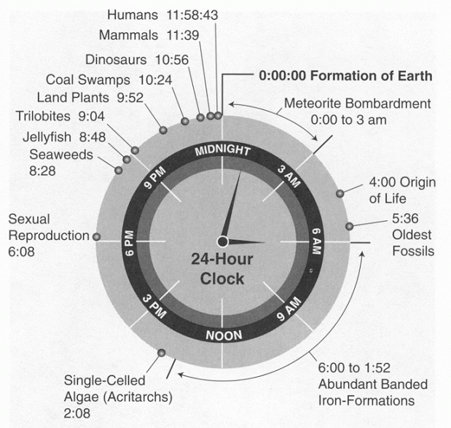
The Anthropocene
The history of the Earth is about 4.6 bilion years. It's really hard to imagine that kind of time period. Human kind is on the planet for around 200 000 years - still it's super difficult to think about it. It's easier if we compare all the time on the Earth to the 24 hours of day. And then we can say that human kind appeared at a bit more than a minute before the midnight.
For the Planet it's literally a blink of an eye!
Although we are here for not a long time for the last 200 years (it's not even 1 second on the clock scale!) We already have a huge impact on the whole planet.
That is why the scientists call this period of such a singnificant changes the age of human - the anthropocene
https://flowingdata.com/2012/10/09/history-of-earth-in-24-hour-clock/

Slide 15
Biodiversity
Climate change affect on:
Without biodiversity the world as we know it doesn’t work, everything has a place in the circle of life.
The vast amount of species provides healthy, stable ecosystems.
For example in highly biodiverse ecosystem like rainforest biodiversity reducing the dependence of one species on another. And then in case of losing one of the species or some disease the whole ecosystem can thrive.

Slide 16
Holocene extinction
Because of the humans activity we are now observing the 6th mass extinction in Planet history.
The most signifficent 5 ones from the past were always related to some changes in the environment. Usually it was caused by volcanic activity, the collapse of the asteroid or the changing of the sea level. Every earlier extinction had occured for a long period but this time it’s super fast.

Slide 17
The ocean
Climate change affect on:
CO2 + sea water = carbonic acid (which causes lower PH of the water)
Presences of this acid threat small ocean creatures like plankton, squid or shellfish, and those animals are crucial for the whole food chain in the ocean. Due to the lower PH of water, it is also no longer possible for corals to build their skeletons. And the coral reef is a natural habitat for many organisms which are also the base of the food chain in this ecosystem.
When we use in this case our knowledge about biodiversity we can deduce that coral reefs as the ecosystems will become weaker and finally disappear. And with them all species that were treating coral reefs as a shelter, place for breeding or the place with plenty of food.

Slide 18
Ice, permanent frost, and glaciers
Climate change affct on:
Due to the rising temperature, we are observing that ice and glaciers are melting. It causes an increase in sea level. It can threaten people living on the coast, and they will be force to migrate. So indirectly the climate change can effect on goblal migrations.
The big surface of the ground that is permanently frosted near to the poles is a natural storage for methane and CO2, so melting these areas are releasing those gases to the atmosphere.

Slide 19
Food and water supplies
Climate change affect on:
Every degree of warming pushes another 7% of us closer to water scarcity, and remember that the population is growing.
Poor quality of food and pollution of water, soil, and crop are the cause of lots of diseases. So climate change can impact also on our health.
A lot of crops also reacting badly for higher temperatures and not stable environmental conditions during growing.
The food supplies effect on climate change:
In general, the food system (when we count deforestation, food production, product transportation, and storage) is responsible for almost half of our general emission of CO2. And for example, just the livestock is responsible for 18%. If we want to stop the global Warming, we need to change our agriculture and food system.

Slide 20
Weather extreme events
Climate change affect on:
The results of current climate change everybody can observe outside our own houses. The extreme weather events like big storms, floods, droughts or massive winds are more frequent now. Those events prove that the climate that we have known is in a transition now, you probably have heard some stories from your grandparents about huge pile of snow during winter. We don’t need scientific evidence anymore, we can see it in our own eyes.
In Poland we are facing the Constance drought, especially in highly industrial areas in the center of the country. The spring is earlier. And during summers we have really heavy rains. Maybe you have some examples of extreme weather event from your country?

Slide 21
We were observing massive forest fires in Amazonia and Australia in recent years. It is also a consequence of climate change, and it was predicted many years ago by the scientist. Nowadays they also have some predictions for the future, for example we need to keep a global temperature rise to well below 2 degrees Celsius. In 2015 during the Climate conference in Paris, 195 countries reached a global agreement to control greenhouse gas emissions to prevent catastrophic consequences of global warming.

Slide 22
Paris agreement
Why this limit is so important? Because if we cross the line the effects of rising the temperature will be continuing even if we will stop the greenhouse gas emissions. Then we will reach the tipping points which means that very moment we will lose the ability to stop further domino effect of constant temperature rising. After some time some plants, and animals (including humans) won't be able to live on this planet anymore.

Slide 23
It’s time to take action!
And this is the last moment for us to take any action. We can’t still wait for the next great invention that saves us without getting out of our sofa. It’s a global, hard work to do right now. The first thing that we can do is to spread the news, which you are already doing by listen to this webinar and I’m really glad that you are interested in this subject.
What else you can do? There are some big actions that need to happen on governmental levels like switching the sources of energy to the clean, renewable ones. As citizens, we have the capability to change what our governments are doing. Remember that you have a right to vote during elections but you also vote with your wallet. Support eco-friendly companies with your money.

Slide 24
An environmental organisations
Everyone of you can join an enviromental orgnisation or be a part of some eco-friendly movement. There are plenty of them around the world. It’s always better to act with somebody by your side.
Also there is plenty of activist actions. Like peaceful protests, marches, petitions or public performences. You can also create a cooperative or community to suport each others. For more brave ones there are strikes, consumer boycotts or civil disobedience.
You can easly find something that fits you and use your skills to save our world. In every organisation there are many things to do
You can: write the articles, take a pictures, make the interviews, lead the workshops or webinars, prepare the broshures or websites, organise an event or protest, give a hand in social media.
What else? It’s up to you ☺

Slide 25
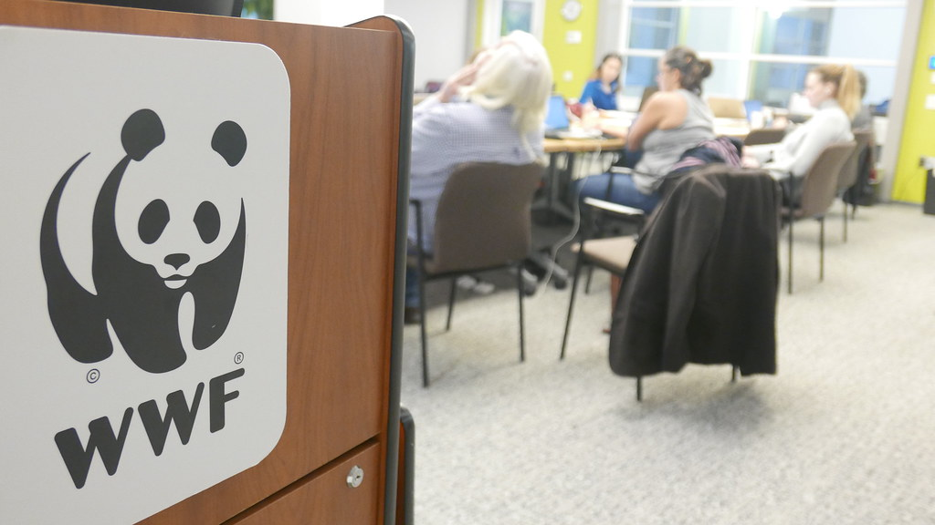
Extinction rebbelion
The World Wide Fund for Nature
They achive their aim by using nonviolent civil disobedience, boycotts, strikes and public performences to force government to take an action to avoid the catastrophic effects of climate change.
The leading organization in wildlife conservation and endangered species.
They make a greeat job with education. They making spots, brochures, guides, books and many others.

Slide 26
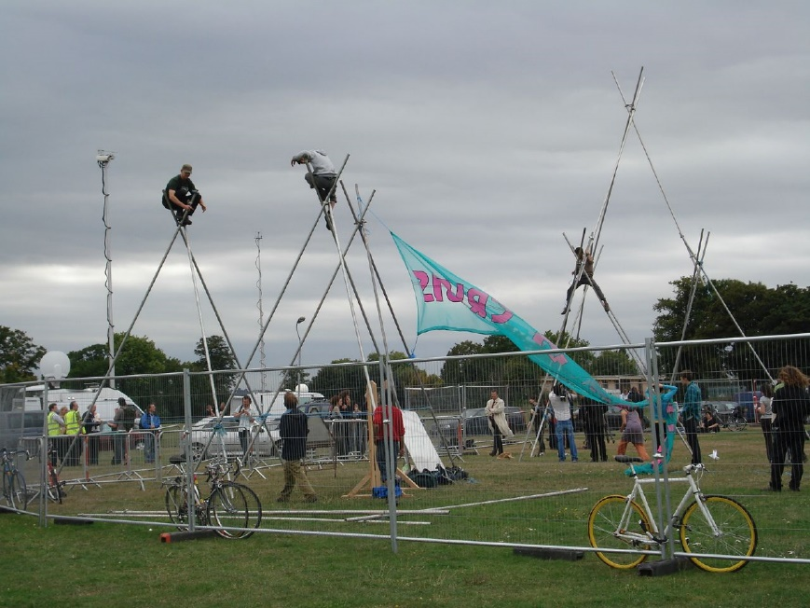
Camp for climate
Youth for Climate (Skolstrejk för klimatet)
Is an international movement of school students who take time off from class on Fridays to participate in demonstrations to demand action from political leaders to take action to prevent climate change and for the fossil fuel industry to transition to renewable enrgy. Started in 2018 by young sweden activist Greta Thunberg but now spreaded the world.
This is a camping gatherings that take place to draw attention to, and act as a base for direct actions against, major carbon emiters, as well as to develop ways to create a zero-carbon society.

Slide 27
My experience
Maybe it wil be an inspiration for you ☺
EVS in Transition Towns organisation (Organic farming, CSA model of farm, permaculture gardens, community gardens an kitchen)
Erasmus+ project about sustainable agriculture in Germany and Spain
II Food Soverignty Forum in Poland
Food cooperative in Gdansk
Community garden in Gdynia
I Sharing my knowledge on blog
I attend to a lot of conferences, meeting and fairs about sustainability, future of food and climate change seminars

Slide 28
Time to act!
There are also plenty of new opportunities for engineers and designers to think about energy-efficiency during the process of production. The business started to be focused and invest more money in “green” startups based on sharing or circular economy. It is urgent to change the food production into sustainable one - but I can already see more products from organic agriculture, increasing amount of alternatives for big supermarkets where people can buy local, fresh food straight from the farmers.
And remember that if we need to decrease our greenhouse gas emissions everyone of us needs to cooperate. You can use public transport instead of your own car. You can save energy by turning off the lights, taking short showers or limiting your usage of smartphones. You can reduce the amount of meat in your diet. You can buy local, seasonal food on markets instead of supporting big corporations. You can go zero waste, try to not buying new stuff (like devices, clothes or decorations), and due to zero waste principals recycle your waste.

Slide 29
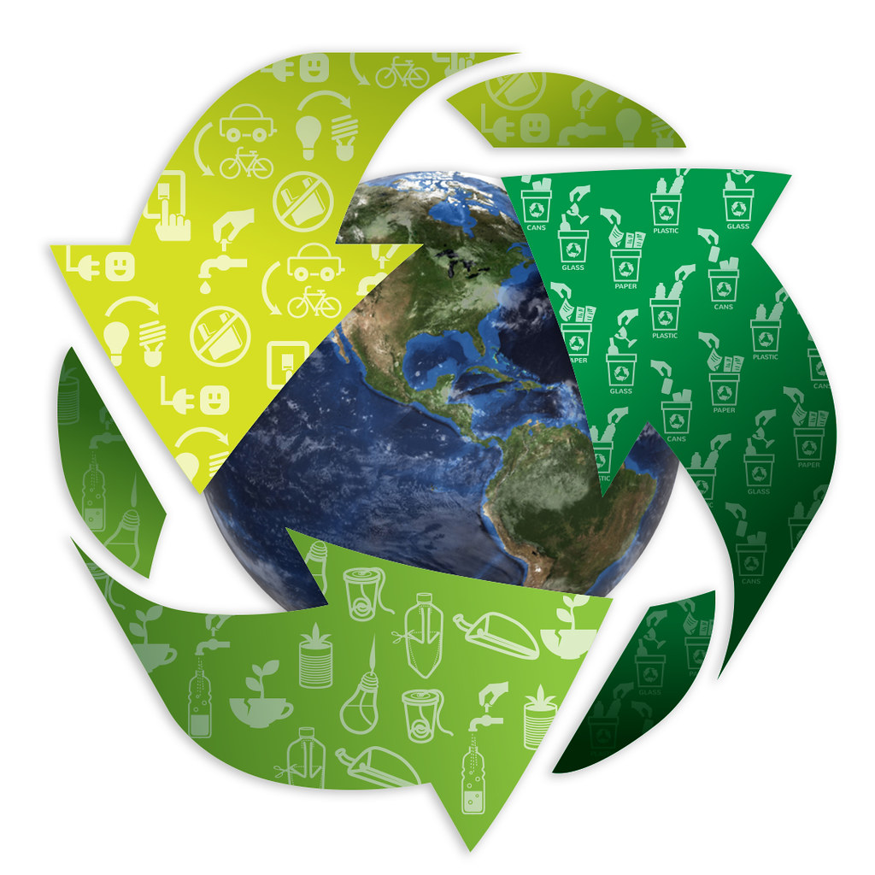
Thank you for your attention
After this presentation, you can already see how everything on our planet is bounded, and the humans are still just a part of the natural ecosystem. We need to save our planet because it is a home for all of us. We need to achieve a sustainable existence, and once again due to another revolution do something that we are really good at - change the world.

Slide 30
Let’s discuss
Do you have any questions or doubts? You want to take a look one again on some slajd?
What action you are already taking to reduce the CO2 emisions and what are your personal goals on this field?
Have you seen the videos? You already saw what effect of cliate changes we were observing during Middle Ages. What do you think about potential consequences of climate change to the system that we are living in?
What do you thing about new economic models that are not based on internal growth? Do you think it will be easy to switch?
Can you tell me why biodiversity is important and what do you think about 6th mass extinction?
Do You have any questions?

Slide 31
Inspiration:
https://www.youtube.com/watch?v=SxbprYyjyyU
https://www.youtube.com/watch?v=gUhxcdzRgLQ
https://www.youtube.com/watch?v=mVIF4FThR5o
https://www.youtube.com/watch?v=I-4F5MJEeqs
https://www.youtube.com/watch?v=-D_Np-3dVBQ
https://www.youtube.com/watch?v=O7PPd_0a9Mw
https://www.youtube.com/watch?v=SAZAKPUQMw0
https://www.youtube.com/watch?v=4fkcTA7YX44
https://www.youtube.com/watch?v=YF8AAJSTJoM
https://www.youtube.com/watch?v=CUfTM-BC-ek
https://www.youtube.com/watch?v=DkZ7BJQupVA
https://www.youtube.com/watch?v=MEX2J_sAdGs
https://youtu.be/z9gHuAwxwAs
https://youtu.be/0MXP2E09dJQ
https://youtu.be/_MT2umCcEwc
What is citizens’ assembly https://www.youtube.com/watch?v=4kOGdq-9jXM
Good news: https://futurecrun.ch/99-good-news-2019
Documentary film: „Before the flood” it supose to be at Netflix „In transition”, „In transition 2.0” „Anthropocene: The Human Epoch”

